Slide 1
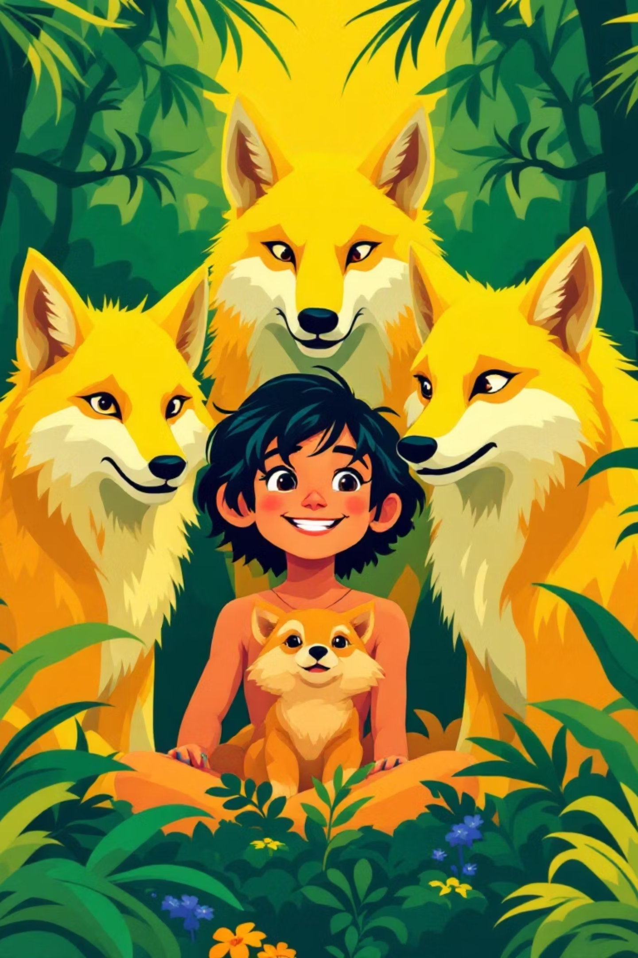
Mowgli's Family: An English Lesson Adventure!
Welcome, young explorers! Today, we're diving into the enchanting world of the jungle to discover what makes Mowgli's family so special. Get ready for a lesson filled with adventure, new words, and exciting stories!

Slide 2
Our Jungle Mission: Goals for Today
Understanding the Story
Expanding Vocabulary
We will read and understand a text about Mowgli's family, focusing on important details.
We'll learn and practise words about family, appearance, and character traits.
Building Sentences
Working Together
You'll get to describe characters using "He/She is..." and "They are..." + adjectives.
We'll develop teamwork and communication skills by working in pairs and small groups.

Slide 3
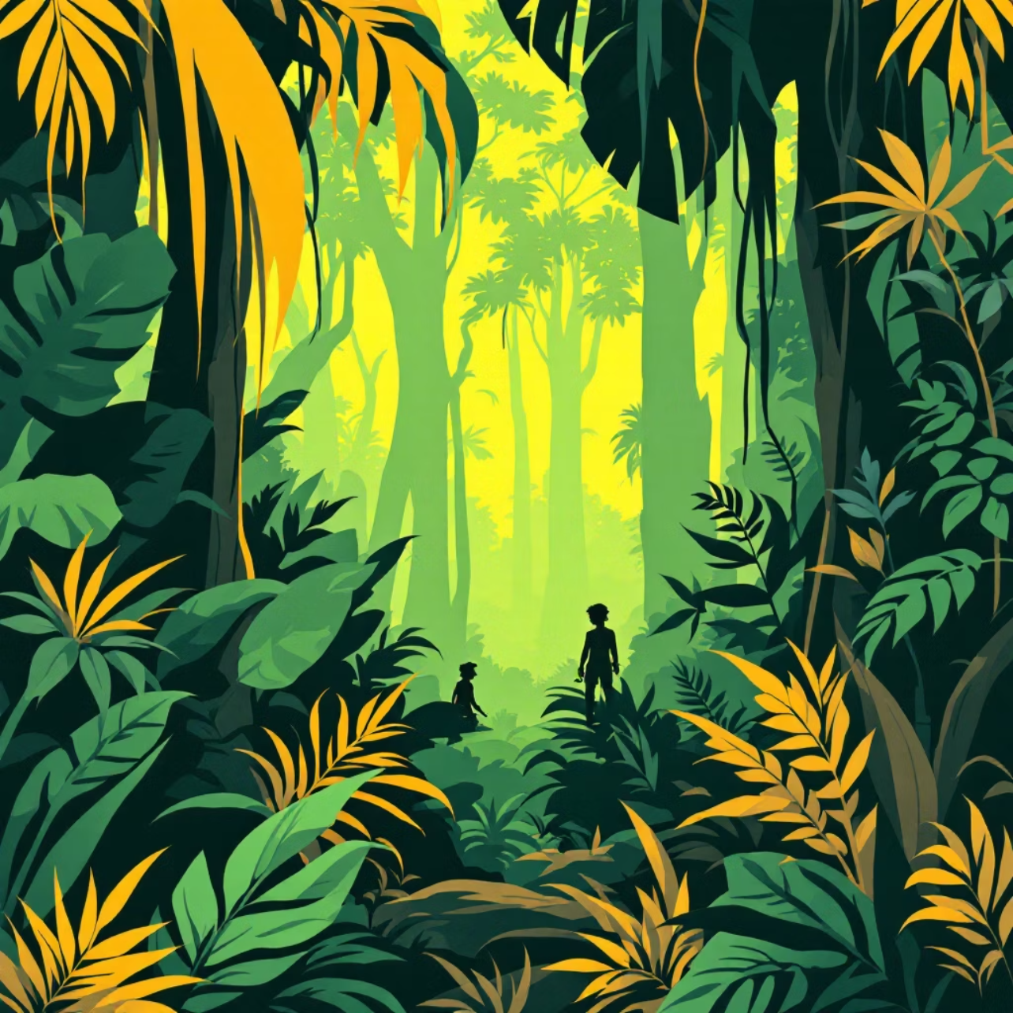
Journey into the Jungle
Hello, Jungle Explorers!
How are you today? What day is it? What's the date? And how's the weather?
Look at this mysterious picture! Where are we? Yes, the jungle! Who lives here?
Animals!
Birds!
But can a boy live here too? Let's find out!
A silhouette appears... Yes, it's Mowgli! And who is his family? Let's remember them!

Slide 4
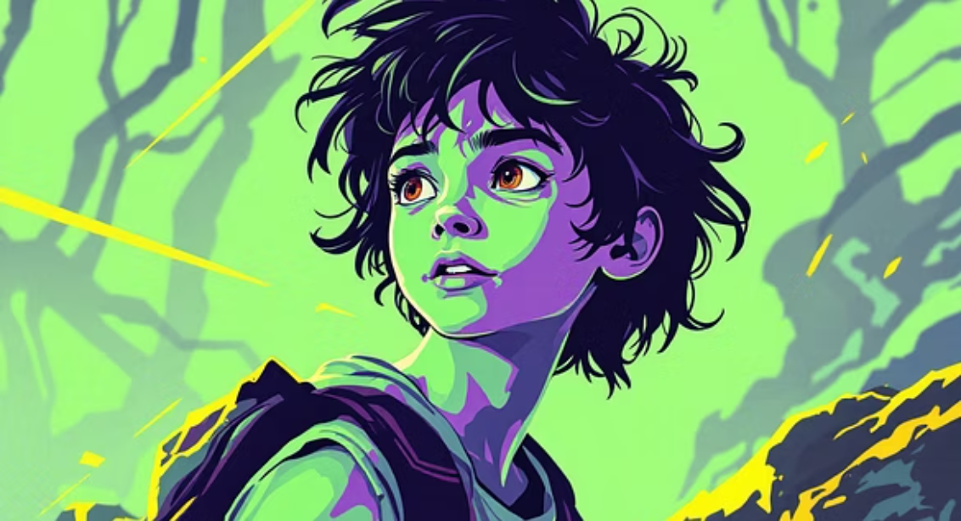
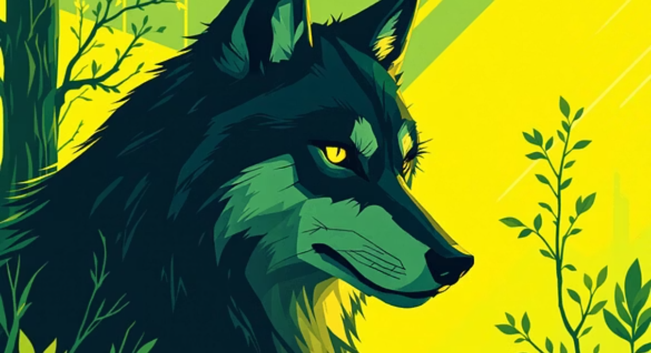
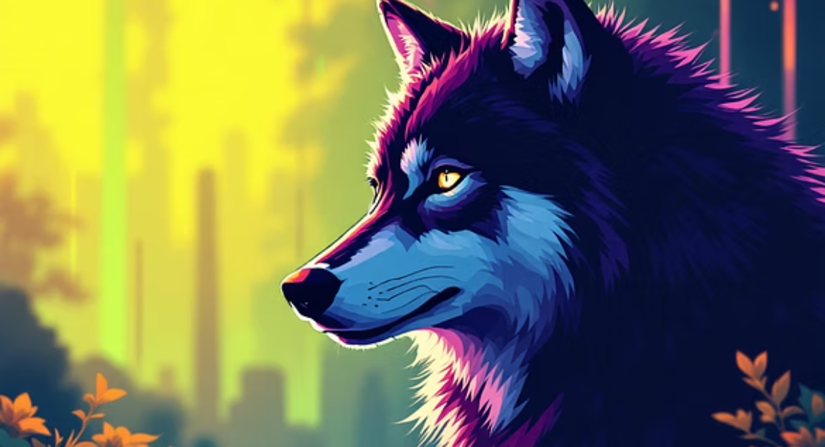
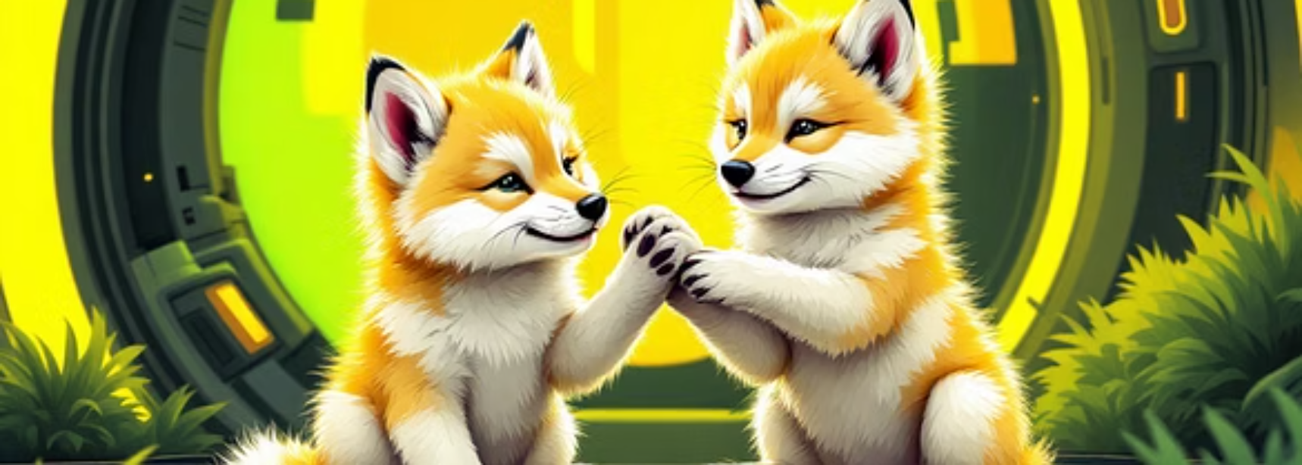
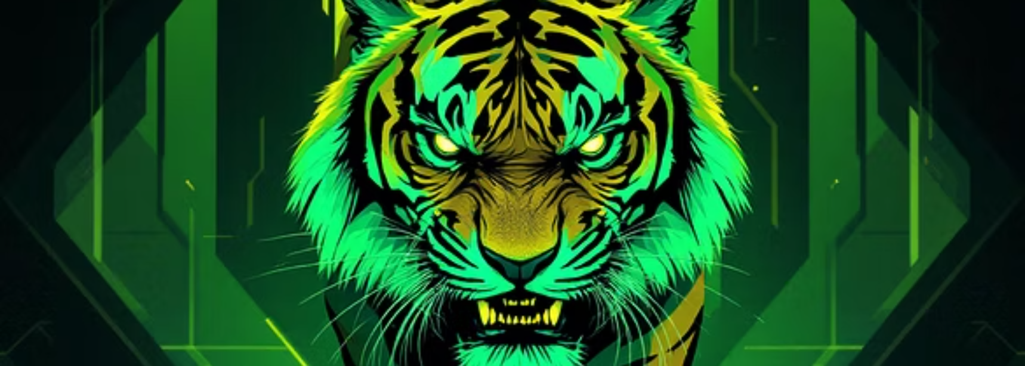
Familiar Faces of the Jungle
Let's meet the characters from Mowgli's world. Can you name them all?
Each character plays an important part in Mowgli's story. Let's remember their roles!

Slide 5
Guess Who? A Character Challenge!
Listen to the description and guess which character I am talking about!
1
2
Strong and Loving
Kind and Brave
He is big and strong. He is a good father. Who is it?
She is very kind and brave. She loves all cubs. Who is it?
3
4
Clever Human
Angry Tiger
He is not an animal. He is a boy. He is clever and brave. Who is it?
He is angry and hungry. He is a tiger. Who is it?

Slide 6
Mowgli's Story: Reading Comprehension
Now, let's test our understanding! Read the questions and choose the correct answers. Remember to find the proof in the text!
1
Wolf Family Size
Mother Wolf and Father Wolf have... cubs.
a) three b) four c) five
2
The Cave Discovery
One day Father Wolf sees a little... near the cave.
a) boy b) girl c) cub
3
Mowgli's Hair Colour
Mowgli has long... hair.
a) fair b) dark c) red
4
Mowgli's Eye Colour
Mowgli has... eyes.
a) black b) brown c) blue
5
Shere Khan's Intentions
Shere Khan wants to... Mowgli.
a) play with b) help c) eat

Slide 7
Rebuilding the Story: "Fill in the Blanks"
Work with your partner to complete the story. Choose Option 1 or Option 2 and fill in the missing words. Let's piece Mowgli's tale back together!
Option 1
Option 2
This is a story about a boy, …... He is brave and clever. He lives in the ……. Animals are his friend. This is a wolf family – …….. and their four children, four wolf cubs. The cubs are little and funny. One day Father Wolf sees a little boy near the ……….. “Man,” says Father Wolf.“A Man’s cub. Look! The boy has long dark hair and brown eyes. He has a little ……………… and a little ………….” “Oh, he’s nice!” says Mother Wolf. They take the boy into their family.
This is a story about a boy, Mowgli. He is …….. and clever. He lives in the jungle. ………. are his friend. This is a wolf family – Father Wolf, Mother Wolf, and their four children, four wolf cubs. The cubs are …….. One day Father Wolf sees a little boy near the cave. “Man,” says Father Wolf.“A Man’s cub. Look! The boy has long ……… and brown eyes. He has a little nose and a little mouth.” “Oh, he’s nice!” ……….. They take the boy into their family.

Slide 8
Jungle Exercise & Sentence Building
Let's move like Mowgli and his friends, then make some sentences!
1
2
Jungle Exercise!
Make Sentences!
Mowgli can run – let's run on the spot!
Use the words below to describe the characters:
Father Wolf is strong – show me your strong arms!
Mother Wolf is kind – give a kind smile to your neighbour!
Mowgli
clever
The cubs are funny – let's jump like little cubs!
Mother Wolf
nice
Shere Khan is angry – say "Grrr!"
Father Wolf
is
The wolf cubs
little
Shere Khan
are
funny
angry
kind
hungry
brave

Slide 9
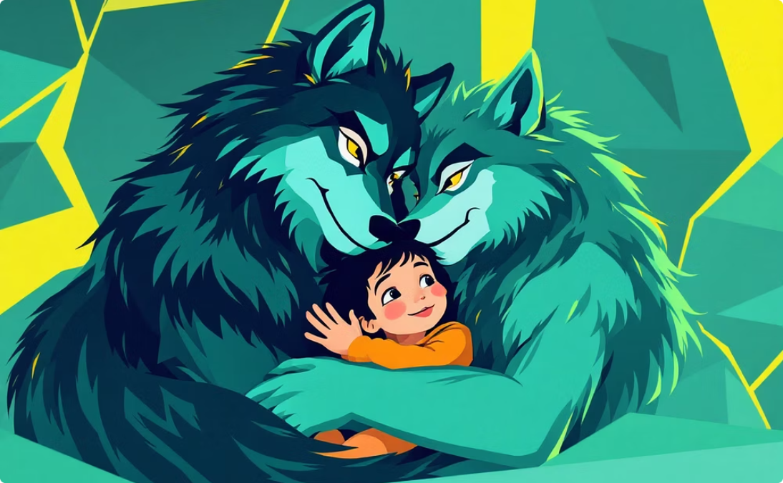
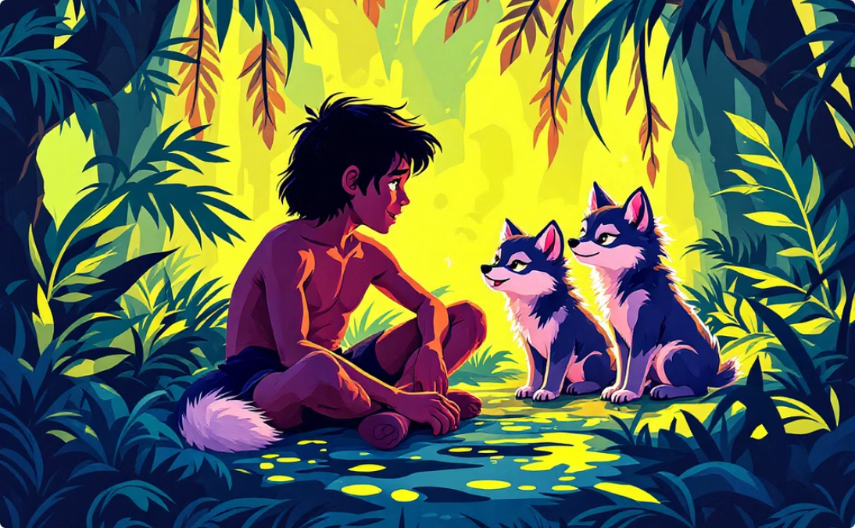
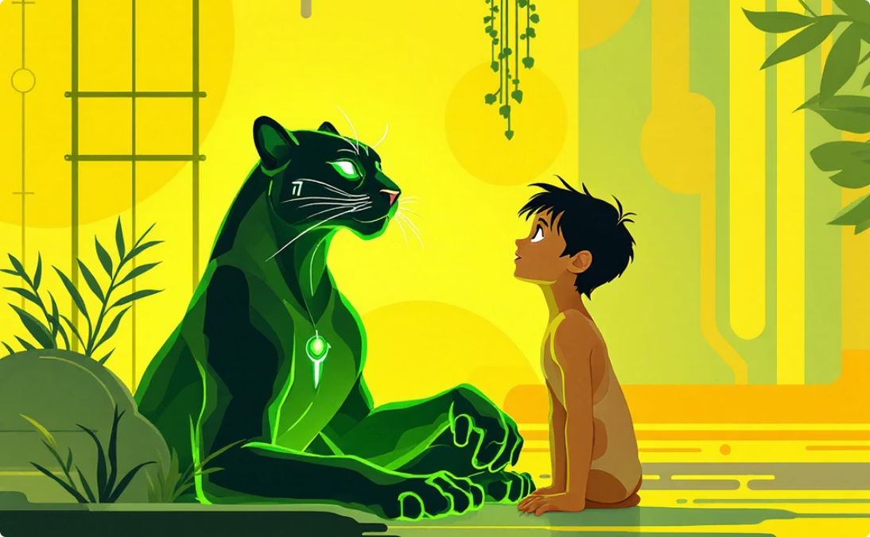
Family Portrait: What does family mean?
In small groups, imagine you are drawing a family portrait. How do these characters treat Mowgli? Do they help him? Use the words on the board to describe their relationship.
The Wolf Family
The Wolf Cubs
Bagheera the Panther
They protect him. They are his family!
They play with him. They are his brothers!
He teaches him. He is his friend!
Remember: They help/hug/protect/play with/teach him. They are his family/friends.

Slide 10
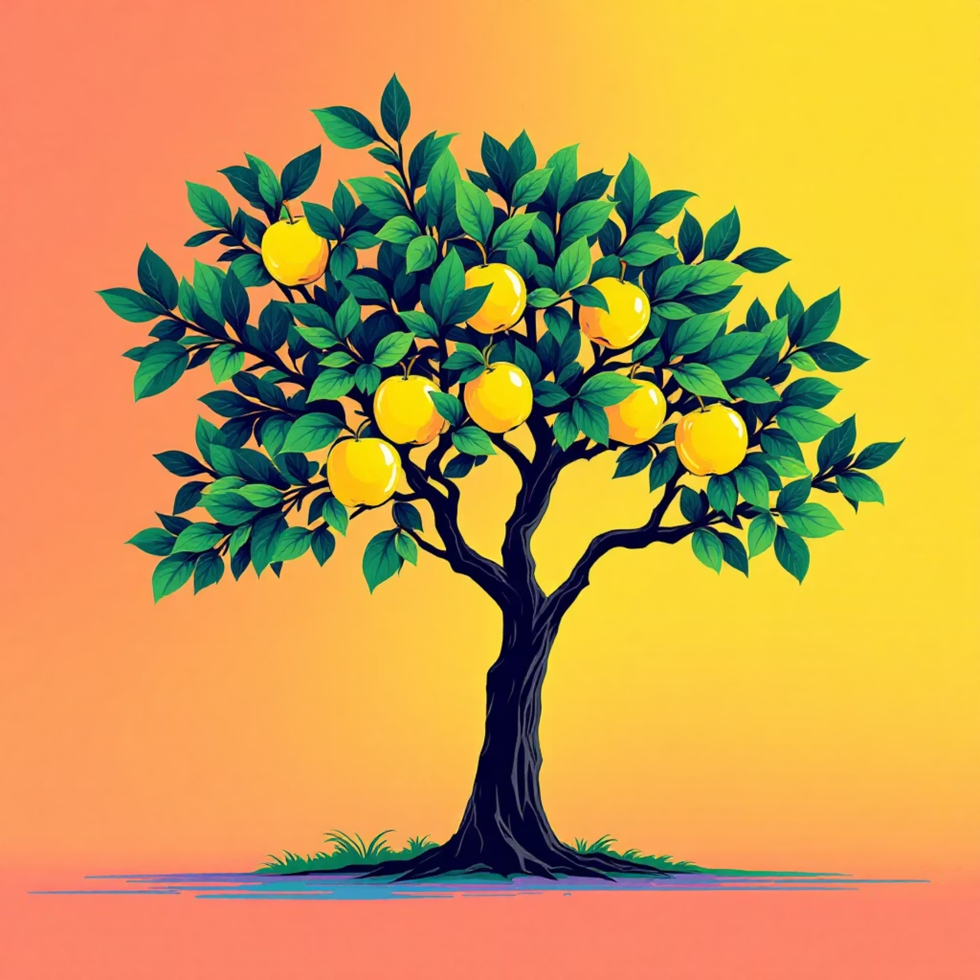
The Family Values Tree & Homework
So, is Mowgli's family usual? What is the most important thing in any family?
Our Family Values Tree
On your green sticker, write one word that you think is most important in a family: love, care, help, support, fun, protection. On your yellow sticker, you can write your own word!
Come up and stick your leaf on the tree, saying: "For me, family is... (love)."
Great job, explorers! Today we saw that family is very important for everyone, even for a boy from the jungle. Thank you for your wonderful work!
Homework:
Draw your own family or Mowgli's family and label the characters (e.g., "This is my mum. This is Mowgli.").

